Slide 1

How your hobby can help advance your profession

Slide 2

Who am I?
Sorta need to understand me and how I was inspired to write this talk.

Slide 3

How does underwater basket weaving help my profession…..
I know you are here to know the answer to this!

Slide 4

Expand your network

Slide 5

Relieve some stress
Exercise, gardening,
Lower blood pressure
Enfiguration

Slide 6

Creativity

Slide 7

RDD – Resume Driven Design

Slide 8
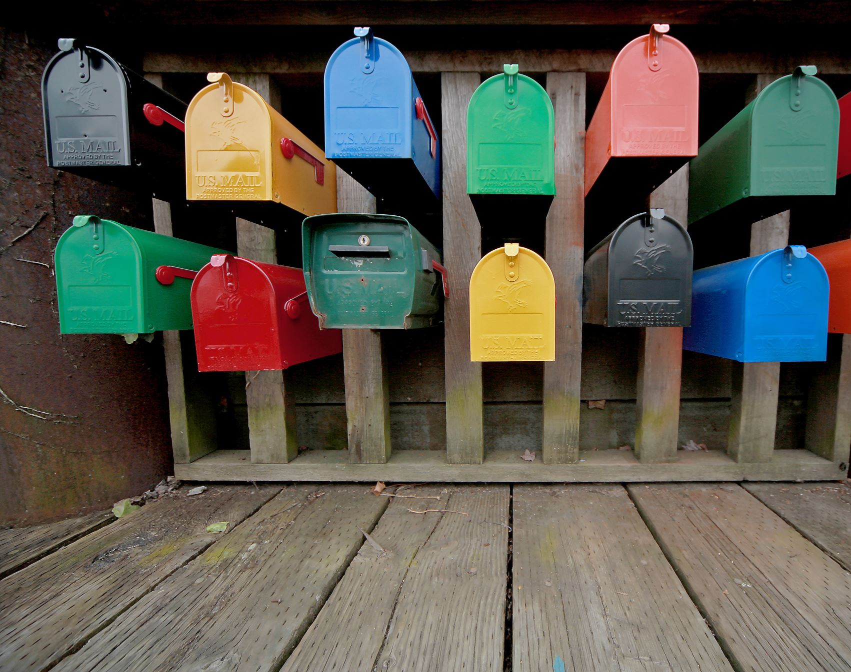
Mailbox Money

Slide 9

Make it a habit
Schedule some time…. With others…
Show off a bit….

Slide 10
Get in the zone to forget your day to day worries.
Bills,
chores,
work,
that creepy person that keeps stealing your lunch…
Watch less TV!

Slide 11

Nothing is on fire…. So you can go deep and enjoy the journey

Slide 12
How to choose?
Must be enjoyable
Doesn’t matter if you are “good” at it
Maybe your hobby chooses you

Slide 13

Better job satisfaction
One point
Two point
Three point

Slide 14

Generally Happier
One point
Two point
Three point

Slide 15

Examples of people and their hobbies
Buffet and his ukileli
Gates reads….. A lot
Steve Jobs
Elon Musk

Slide 16
We can do that?

